Slide 1
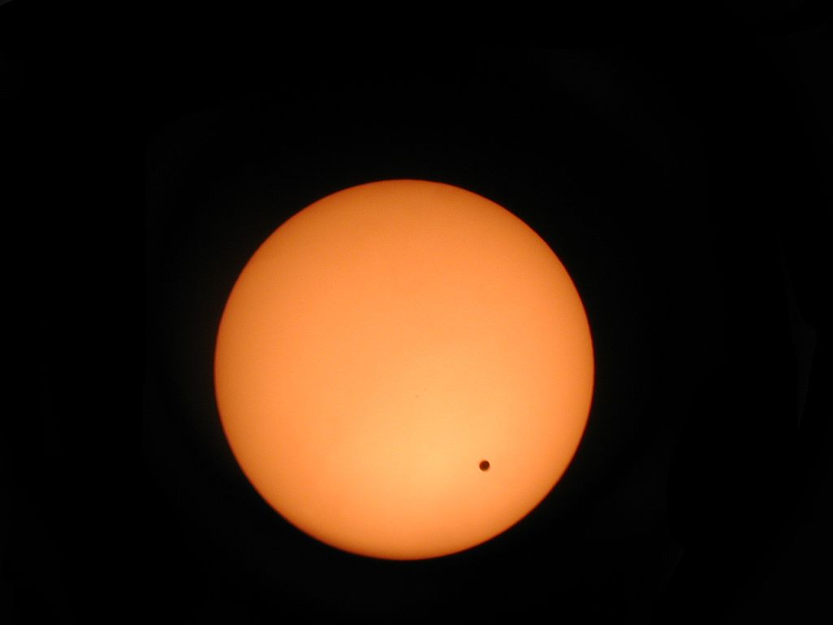
Lec 12: Eclipse Scholars
© Gerard Williger 2023, U Louisville
Scholar: someone who studies eclipses / publishes results for science or the public
Hunter/Chaser: someone who travels to sees many eclipses – LOG FILE
Umbraphile: someone who likes being in totality
Transit: When one object passes in front of another but is too small to cover (eclipse) it
Mercury or Venus in front of Sun
Useful to determine distance to Sun!
Jupiter’s moons in front of Jupiter
Transit of Venus, 2004, Wikipedia

Slide 2
Ancient Astronomers
© Gerard Williger 2023, U Louisville
Petroglyph carvers:
British Isles, Australia, Americas and where they may be found in the future
China:
Shi Shen, 4th cent. BC, predicted eclipses LINK, + others
Chaldea/Babylon:
Kidinnu/Kidenas, d. 330 BC, studied eclipses LINK, + others
Sudines, c. 240 BC, worked on eclipses, may have written a table LINK
Those whose records were lost: Mayans…

Slide 3
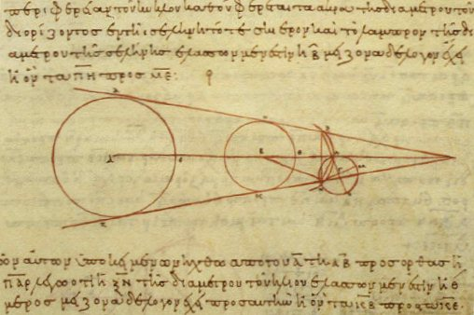
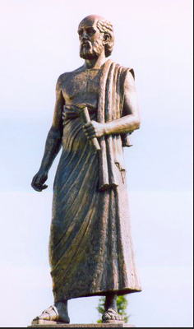
Aristarchus of Samos, c. 310 – c. 230 BC
© Gerard Williger 2023, U Louisville
Greek, Made (one of?) 1st heliocentric model showing Earth orbiting sun and rotating once per day
Wrote On the Sizes and Distances of the Sun and Moon
Estimated that Moon is 1/3 size of Earth based on a lunar eclipse
True value is about ¼
LINK
Aristarchus’ figure showing sizes of Earth and Moon, 10th cent. Greek copy, Vatican collection
Monument of Aristarchus outside Aristotle University of Thessaloniki, Greece

Slide 4
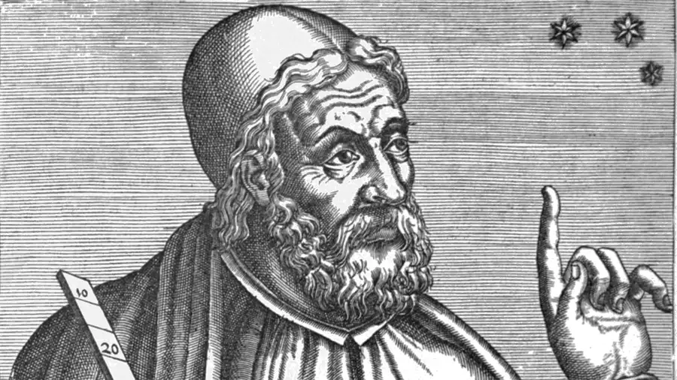
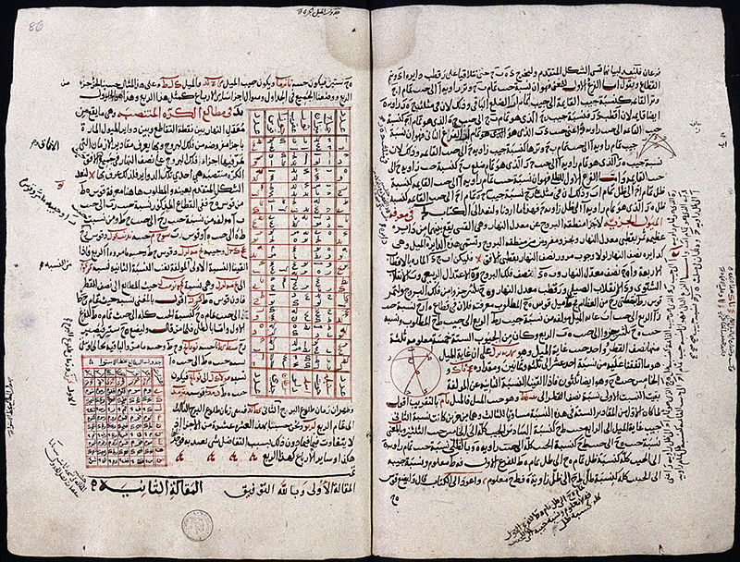
Claudius Ptolemy, c. 100- c. 170 AD
© Gerard Williger 2023, U Louisville
Ptolemy, Wikipedia Commons
Alexandrian polymath, wrote about a dozen treatises Wikipedia
Published Almagest, treatise on astronomy
Used geocentric model: Sun + planets go around Earth
Predicted lunar + solar eclipses
Pages from Almagest, showing astronomical tables. Note it is in Arabic, copied and translated from the original Greek.
-- was major reference for 1400 years
-- good for lunar eclipses
---- solar eclipses more difficult to calculate
Notes:
Almagest is from Arabic Al-Majesti, “The Greatest”, as Arab astronomers copied and translated Ptolemy’s works from the Greek

Slide 5
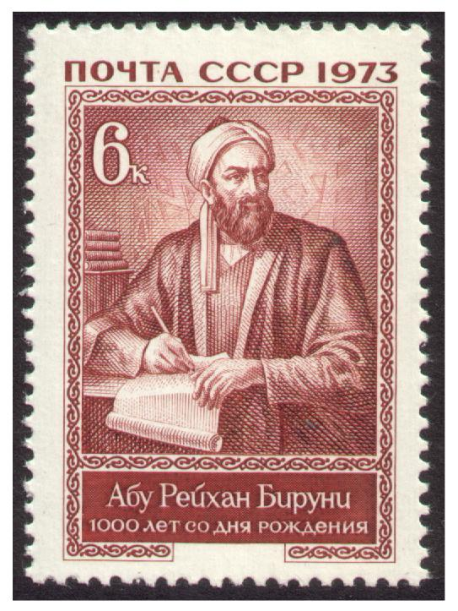
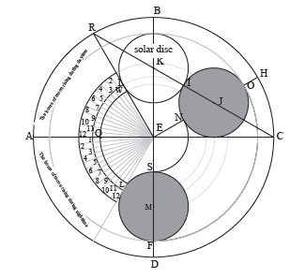
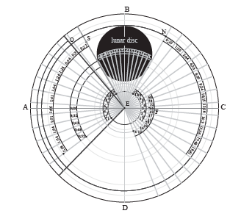
Ahmad al-Biruni, 973 – after 1050
© Gerard Williger 2023, U Louisville
Persian scholar and polymath, LINK
Kept record of eclipses
Published illustration showing lunar eclipses to be caused by the shadows of Earth
Made an “eclipse plate” to calculate lunar eclipses
Soviet stamp, 1973
Front (top) and back (bottom) of eclipse plate, from Flora Vafea 2016, Int’l J. for History of Exact and Nat. Sci. in Islamic Civilisation

Slide 6
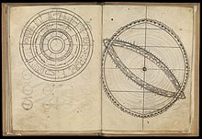
Al-Zarquali + Astronomers of Toledo
© Gerard Williger 2023, U Louisville
Toledan Tables (LINK) done c. 1080 by Arabic group including al-Zarquali (1029-1100)
Updated Almagest calculations
Predicted planet motions, eclipses
Updated again by Alfonsine Tables (1483)
“The Canones”, translation of a diagram from the Toledan Tables by Gerardus Cremonsis.
Alfonsine Tables still used geocentric system
Notes:
The other group members are largely unknown. The Toledan tables were copied often, and errors crept in. Alfonsine Tables named for Alfonso X (1252),
Who commissioned translations of astronomical works from Arabic to Castilian.

Slide 7
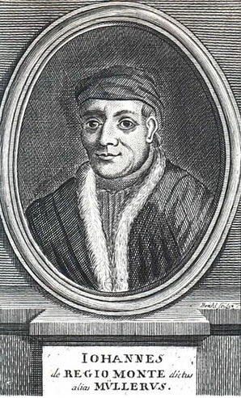
Johannes Müller von Königsberg, 1436-76
© Gerard Williger 2023, U Louisville
German, a.k.a. Regiomontanus, from Königsberg in Franconia
Was a very fast and accurate numerical calculator LINK
Completed update of Almagest started by his teacher, Georg von Peuerbach
wrote updated lunar eclipse tables used by Columbus in 1504, who used Alfonsine Tables
Was teacher of Copernicus’ teacher
May have considered heliocentric theory (Earth goes around Sun)
Regiomontanus, woodcut by Johann Benjamin Brühl (1691-1763)
Notes:
Note this is not the Königsberg of East Prussia.

Slide 8
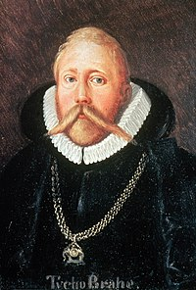
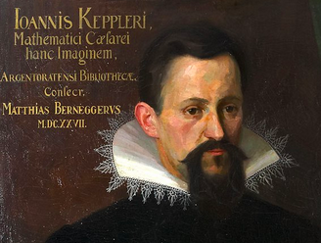
Tycho Brahe & Johannes Kepler
© Gerard Williger 2023, U Louisville
Danish, Brahe (1546-1601) took precise observations
German, Kepler (1571-1630) used them with heliocentric model and elliptical orbits to make Rudolphine Tables (1623) LINK
Most accurate yet for planet positions, eclipse + transit predictions
Predicted Mercury transit 1631, observed by Fr. Pierre Gassendi (1st ever observed)
Used to predict Venus transit 1639
Tycho Brahe, painting by Eduard Ender (1822-83), public domain
Johannes Kepler, 1620, by unknown artist, public domain, Kepler Museum, Weil-der-Stadt, Germany

Slide 9
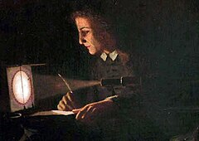
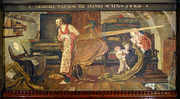
Jeremiah Horrocks & William Crabtree
© Gerard Williger 2023, U Louisville
English, Followers of Kepler, corrected his Rudolphine Tables by observation and measurement
Horrocks (1618-41) - only person to predict transit of Venus in Dec. 4, 1639 LINK
Only he (Preston) and his astronomer friend William Crabtree (1610-44) (Manchester) observed it
Estimated Earth-Sun distance 2/3 of present value (best at time) LINK
J. Horrocks, idealized painting by Wm. Lavender, 1903
W. Crabtree, Manchester Town Hall, England

Slide 10
Capt. Thomas James, 1593-1635
© Gerard Williger 2023, U Louisville

Slide 11
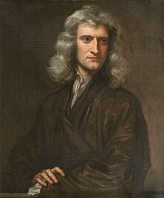
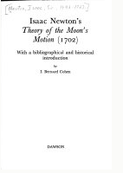
Sir Isaac Newton 1642-1727
© Gerard Williger 2023, U Louisville
English polymath, formulated theory of gravity, laws of motion (Principia, 1686) LINK
Published A new and most accurate theory of the moon’s motion, 1702, includes perturbations by the Sun
Sir Isaac Newton, 1689, by Godfrey Kneller (Isaac Newton Institute)

Slide 12
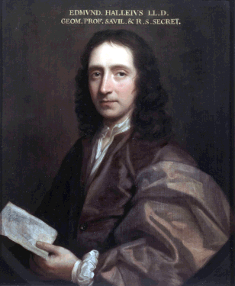
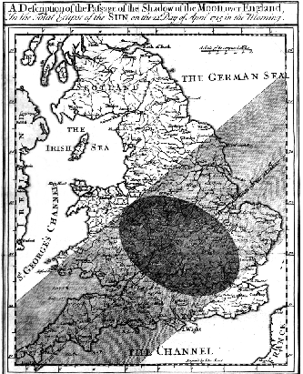
Edmond Halley 1656-1742
© Gerard Williger 2023, U Louisville
English, Observer and mathematician, friend of Newton
Helped persuade Newton to publish Principia and Theory of moon’s motion (John Dvorak 2017)
Used Newton’s results to predict eclipse path, 1715
Observed sunlight through lunar valleys
Predictions:
Good to within a few miles and two minutes
Enabled eclipse expeditions
Proposed using Venus transits of 1761, 1769 to calculate distance to Sun
Halley, c. 1690
Halley’s eclipse path map, 1715
Notes:
Noted what were to be called Baily’s beads.

Slide 13
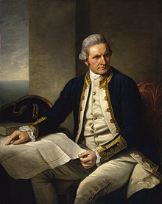
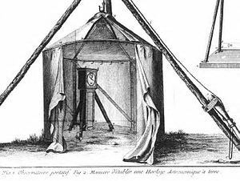
Capt. James Cook, 1728-79
© Gerard Williger 2023, U Louisville
English, Observed annular solar eclipse Aug 5, 1766, calculated longitude around Newfoundland, published 1767 LINK
Observed Venus transit June 3, 1769 from Tahiti
helped with other observations to determine distance to Sun to 0.8% LINK
Capt. Cook, c. 1775, by Nathaniel Dance-Holland, National Maritime Museum, England
Portable observatory used by Cook, 1769, containing an astronomical clock (engraved by Robert Benard).

Slide 14
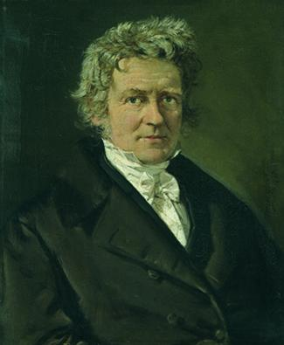
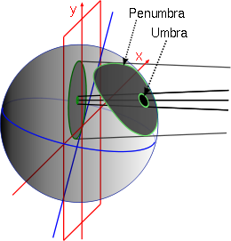
Friedrich Wilhelm Bessel, 1784-1846
© Gerard Williger 2023, U Louisville
German polymath, Dir. of Könisberg Observatory, Prussia 1810-1846
1824 developed new, simpler method to calculate eclipses
Used spherical geometry to plot Moon’s shadow
8 Besselian Elements
Also used for transits, occultations (eclipses) of stars
Bessel 1839, by C.A. Jensen
Besselian Elements for total eclipse. Red: fundamental plane. Gray: Earth. Green: Earth surface plane.

Slide 15
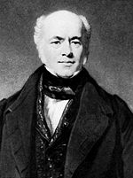
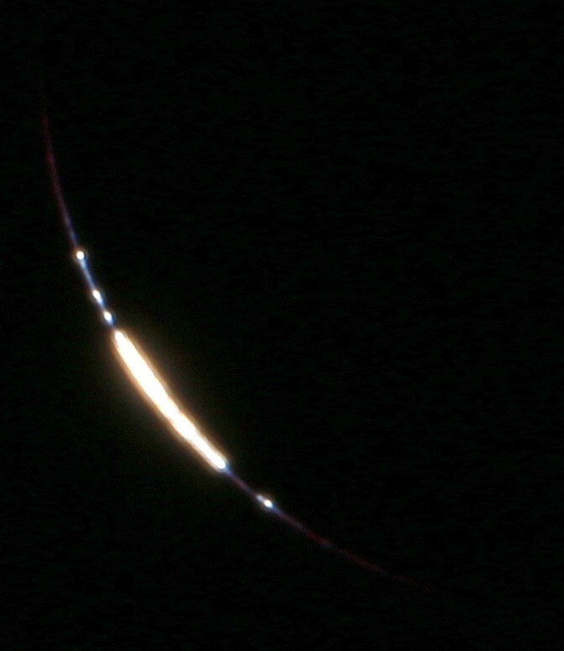
Francis Baily, 1774-1844
© Gerard Williger 2023, U Louisville
English astronomer. Led foundation of Royal Astron. Society, 1820.
Saw 1820 eclipse (partial in England) reflected on water
Saw 1836 annular eclipse, sunlight through lunar valleys, “Baily’s Beads”
Saw 1842 total eclipse from Pavia, Italy
Francis Baily, undated, Royal Astronomical Society
Baily’s Beads, 4 sec before totality, Aug 21, 2017, by Tom Ruen

Slide 16
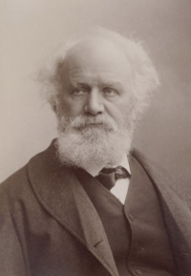
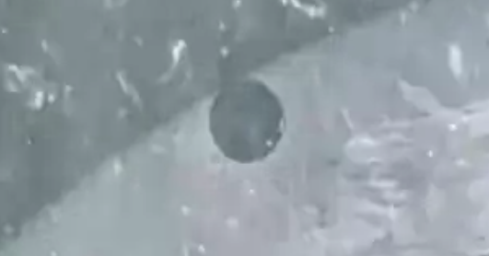
Pierre Jules Janssen, 1824-1907
© Gerard Williger 2023, U Louisville
French, co-discovered helium in solar corona, 1868 eclipse, India
Observed eclipses in 1867 (Italy), 1870 (Algiers), 1883 (Caroline Is.), 1905 (Spain).
Had to escape Paris by balloon in 1870 – then clouded out!
Observed Venus transits in 1874 (Japan), 1882 (Algeria)
Janssen, taken 1875-95, by Gaspard-Félix Tournachon
Venus transit, 1874, see LINK for 6 sec “video”, Wikipedia
Notes:
Siege of Paris in 1870 was from Franco-Prussian War

Slide 17
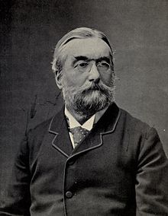
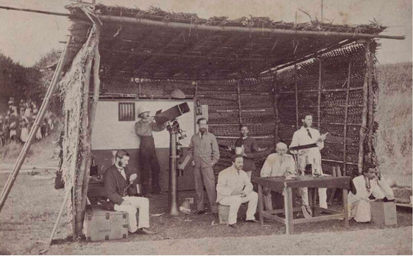
Sir Norman Lockyer, 1836-1920
© Gerard Williger 2023, U Louisville
English, Co-discovered helium using spectroscope, 1868
Founded journal Nature
Led 8 total eclipse expeditions, including:
1870 - Italy, ship wrecked, clouds but for 1.5 sec totality
1871 - India, slept with scorpions/snakes, on opium for fever
1878 - Colorado, paid own way, w. Simon Newcomb
1898 - India, climbed mountain age 69
Lockyer, c. 1897
Lockyer, Henry Holiday and expedition to Poodoocottah, Dec. 1871

Slide 18
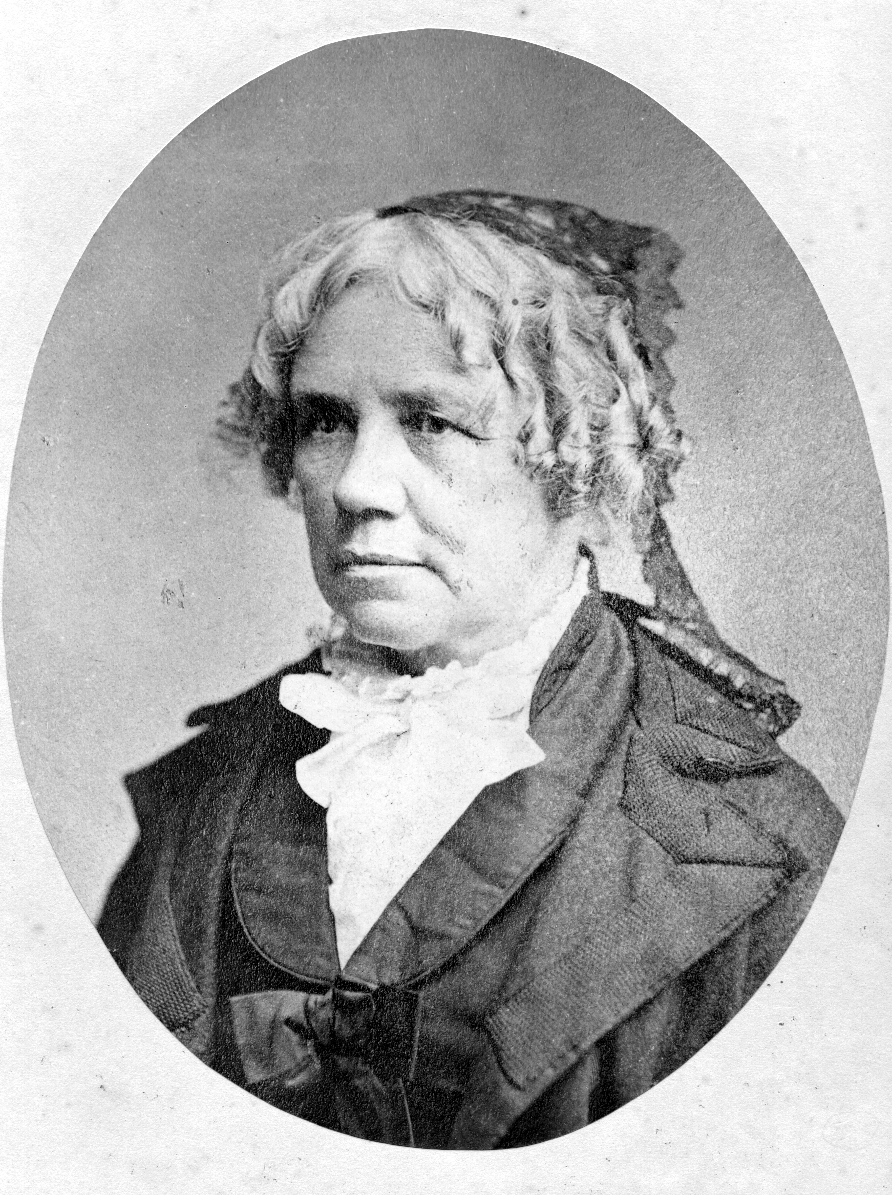
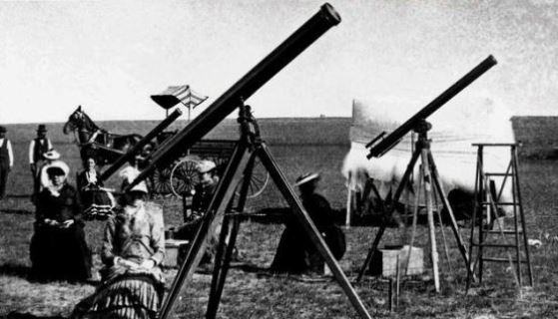
Maria Mitchell, 1818-89
© Gerard Williger 2023, U Louisville
US, 1st Astro Prof at Vassar
1831, helped her amateur astronomer father calculate moment of an eclipse
1847 discovered a comet
1869 eclipse, organized trip with students to Iowa (got no gov’t $)
May 6, 1878, observed Mercury transit
Jul 29, 1878 eclipse, organized trip with 5 women to Denver (got no gov’t $)
Dec 6, 1882, photographed Venus transit
Maria Mitchell, undated, Nantucket Historical Assoc.
1878 eclipse expedition to Denver

Slide 19
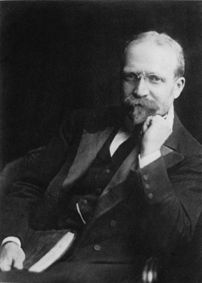
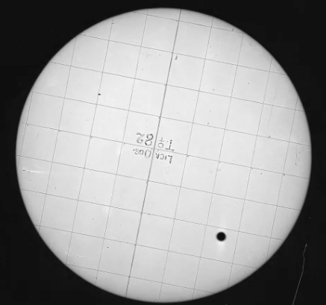
David Peck Todd, 1855-1939
© Gerard Williger 2023, U Louisville
David Todd, undated, Amherst Coll. Archives
US, Prof at Amherst College, got BA age 20, LINK
Wrote Venus transit calculations 1874
Chief astronomer, Venus transit 1882, Lick Obs. (CA)
Observed 19 eclipses (many cloudy), led 12 expeditions, 1878-1919
Photo from 1882 Venus transit, D. Todd. LINK to 20” animation. He developed techniques to improve both transit and eclipse photography.

Slide 20
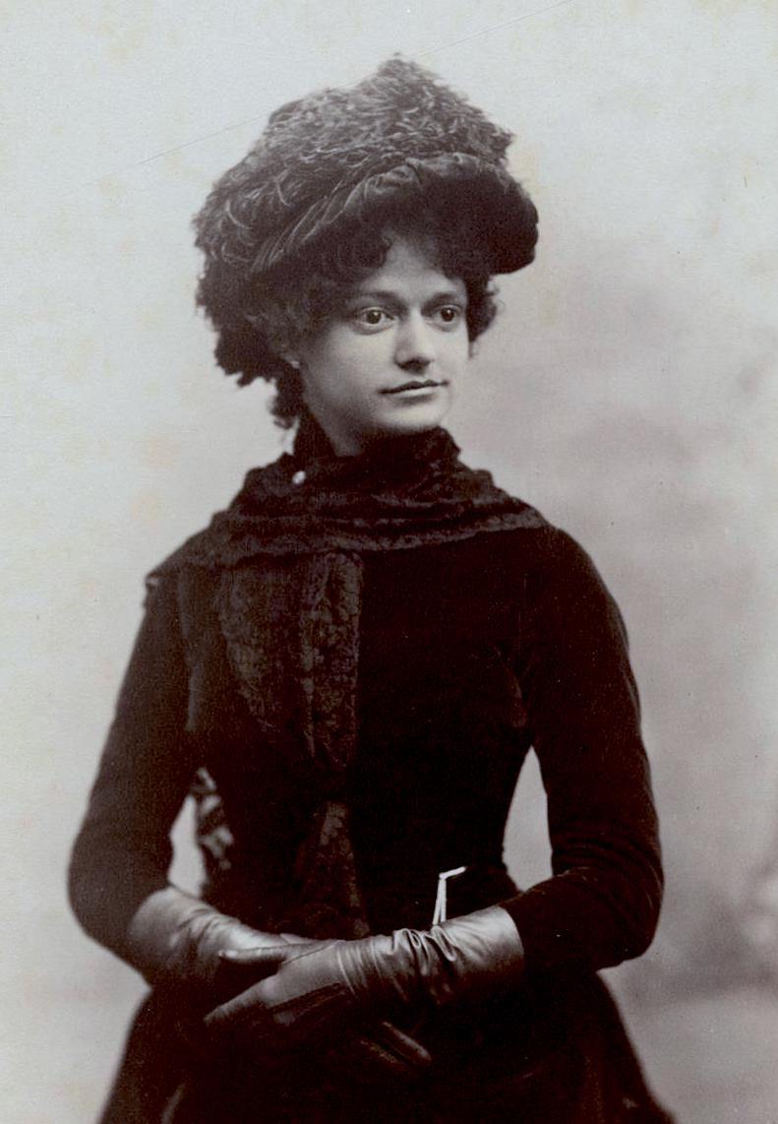
Mabel Loomis Todd, 1856-1932
© Gerard Williger 2023, U Louisville
US, Pianist, singer, writer LINK
Married David Todd 1878
Went to 7 eclipses, 1887-1914
Wrote travel+science:
Total Eclipses of the Sun, 1894
Corona and Coronet: … Amherst Eclipse Expedition to Japan, 1898
Gave eclipse lectures
Mabel L. Todd, 1883, Yale U. Library
Also co-wrote with Joel D Steele, Popular Astronomy; being the New descriptive astronomy, 1899
Emily Dickinson’s first editor
Notes:
Mabel Todd never met Emily Dickinson, though she knew the family.

Slide 21
Simon Newcomb
© Gerard Williger 2023, U Louisville

Slide 22
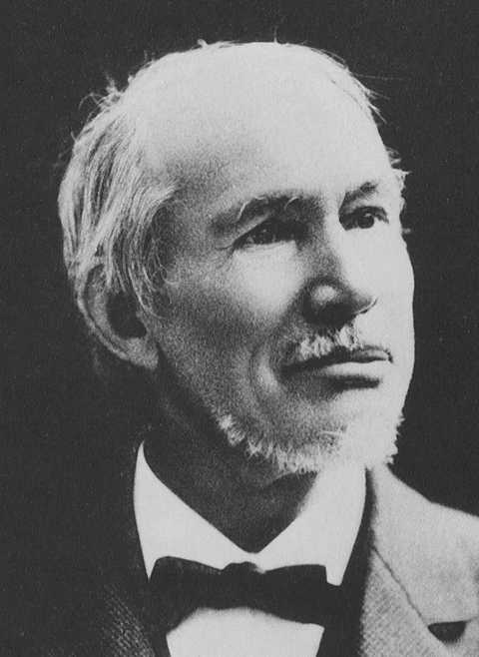
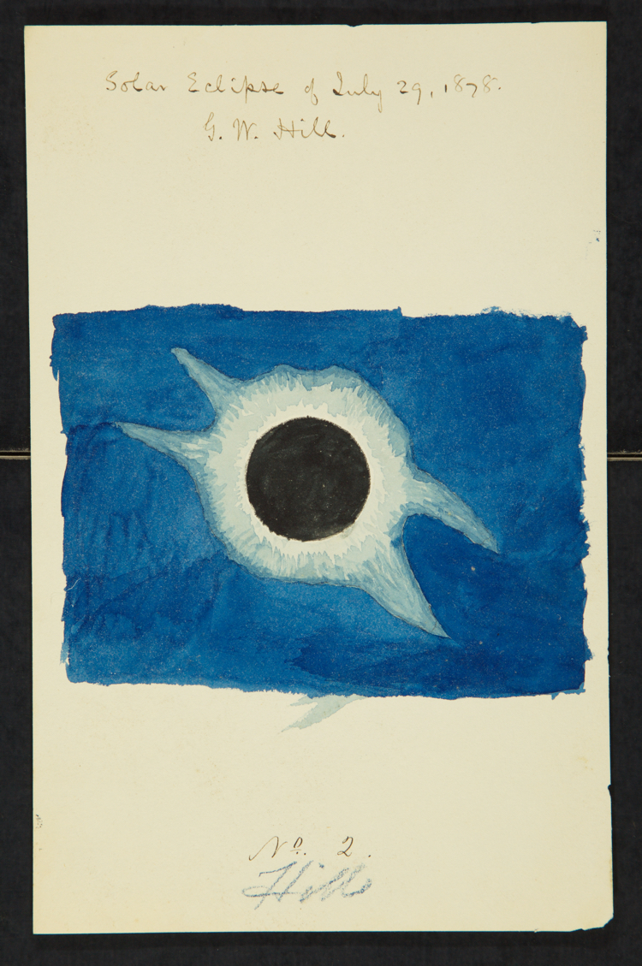
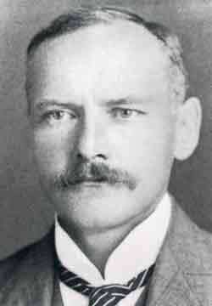
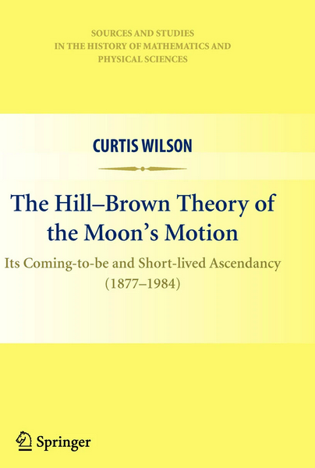
George W. Hill & Ernest W. Brown
© Gerard Williger 2023, U Louisville
US, Hill (1838-1914)
worked on 3 and 4 body problems, solved “apsidal (perigee) precession” of Moon posed by Newton
Worked for US Naval Obs. 1861-92(?)
Engl.-Born, US-naturalized Brown (1866-1938)
Worked on Moon’s motion
Taught at Haverford and Yale
Published Hill-Brown theory 1908, superceded 1984 by computer models
George Hill c. 1905 (top) and Ernest Brown undated (bottom, Amer. Mathematical Soc.)
Hill watercolor, 1878 eclipse, US Nat’l Archives, scanned & courtesy D. Baron
Hill-Brown theory of lunar motion, started by Hill, finished by Brown, was standard 1877-1984. Moon’s motion is most complex in Solar System.

Slide 23
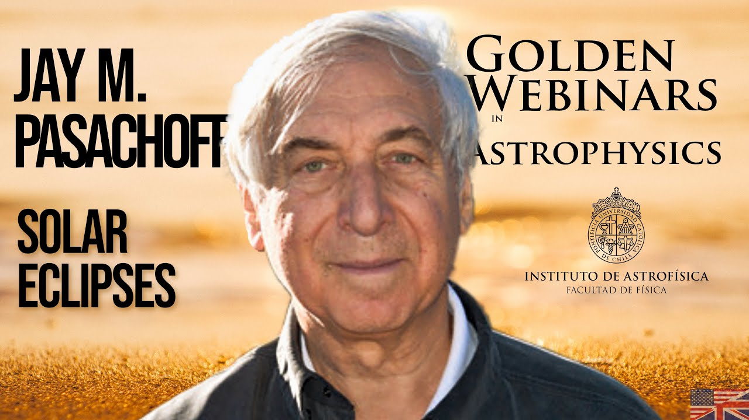
Jay Pasachoff, 1944-2022
© Gerard Williger 2023, U Louisville
US, Studied solar physics,observed eclipses, transits 1959-2022
AB, PhD Harvard, Prof at Williams College
Probably saw more eclipses than anyone in history (74 observations, ~1.5 hrs totality) – NY Times
From webinar, Inst. Astrofisica de Canarias, Mar 9, 2021, LINK to 1.5hr video
191 refereed papers, 1868 citations, many on science of eclipses, also history of eclipses
He wrote many books, including the textbook The Cosmos with A. Filippenko, and continued A Field Guide to the Stars & Planets, started by his teacher, Donald Menzel
This course is dedicated to his memory.

Slide 24
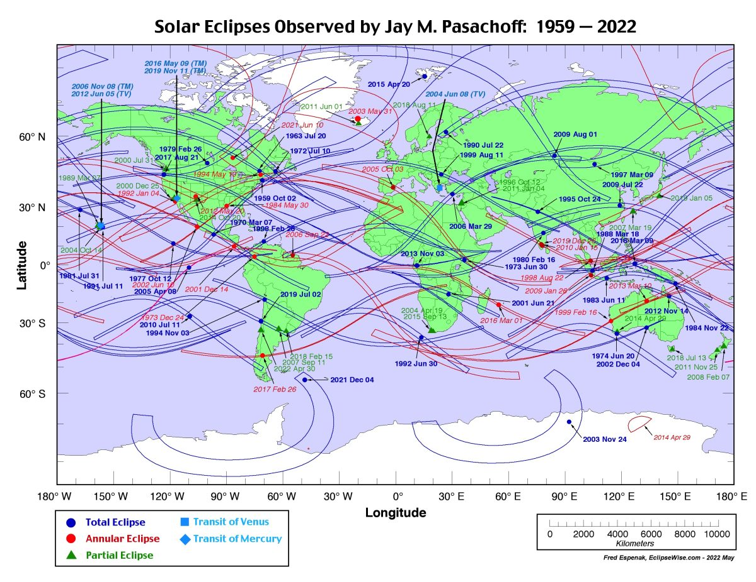
Jay Pasachoff’s Eclipses/Transits
© Gerard Williger 2023, U Louisville
Science from eclipses, with Jay Pasachoff -- 1’ video, Quanta Magazine, Aug. 10, 2017
From Williams College eclipse-site

Slide 25
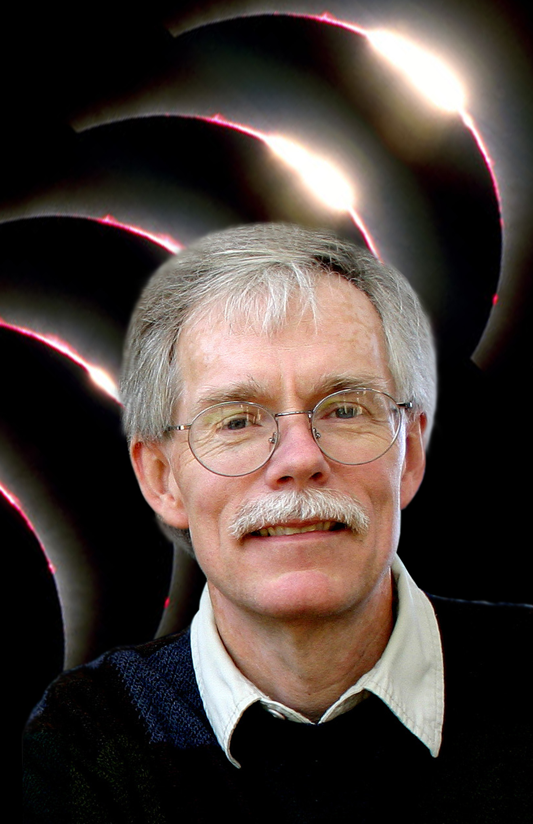
Fred Espenak - I
© Gerard Williger 2023, U Louisville
Photo for 2016 Bullitt Lecture, U. Louisville
US, BS ’74 Wagner College (NYC), MS ’76 Toledo, on flare stars
1st telescope at age 9-10
Worked at NASA Goddard Space Flight Center
Started NASA eclipse site LINK
Wrote eclipse bulletins
Known as “Mr. Eclipse”
Observed 30 eclipses since 1970
Wrote >30 eclipse books
Wrote Fifty Year Canon of Solar Eclipses: 1986-2035,
also with Jean Meeus, Five Millennium Canon of Solar Eclipses (2006), which covers from 2000 BC to 3000 AD
Runs 3 websites:
www.EclipseWise.com – predictions
www.MrEclipse.com – photography
www.AstroPixels.com - astrophotography

Slide 26
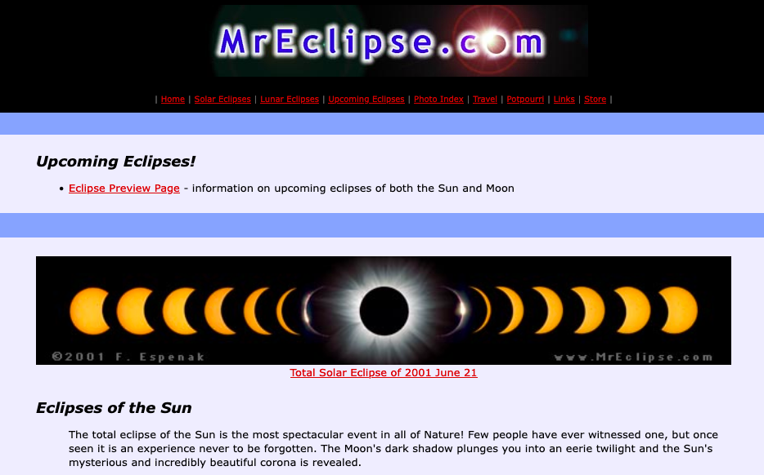
Fred Espenak - II
© Gerard Williger 2023, U Louisville
Interview, Time Magazine, Aug. 16, 2017 3.6’ VIDEO
"There's no way to oversell how spectacular and incredible seeing a total eclipse is. A lot of people think they've seen an eclipse. What most of them have seen a partial solar eclipse. But a partial eclipse, even -- a 99% partial eclipse, pales in comparison to seeing a complete, 100% total eclipse of the sun.” - Fred Espenak (private communication, Nov 21, 2023)

Slide 27
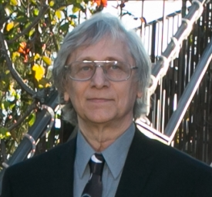
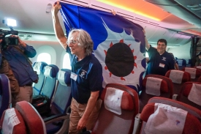
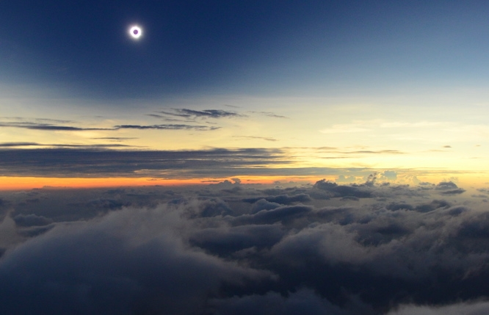
Glenn Schneider
G. Schneider, U Arizona, undated
© Gerard Williger 2023, U Louisville
American, BS ’76 NY Tech, PhD ’85 Florida ’77, worked at Space Telescope Sci Inst 1985-94; Prof. at Arizona
Research on proto-planetary disks; Hubble Space Telescope Near-IR Camera Project Scientist
NASA Public Service Achievement Award
150 refereed papers, >7000 citations
1 on eclipse rainbows, 1 on transits
Seen at least 35 eclipses since 1970 – LINK1 (article) ; LINK2 (log)
Pioneered eclipse observations from aircraft
Videos w. Dr. Schneider LINK1 (6’), LINK2 (54’), LINK3 (1h), LINK4 (47’), LINK5 (flight, 4.5’)
Schneider and others enroute to Easter Island for July 2019 eclipse.
Schneider’s view of 2013 eclipse over Kenya and dust storm
Notes:
Schneider missed 3 eclipses and was clouded out for 3 more, since 1970.

Slide 28
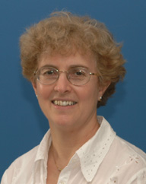
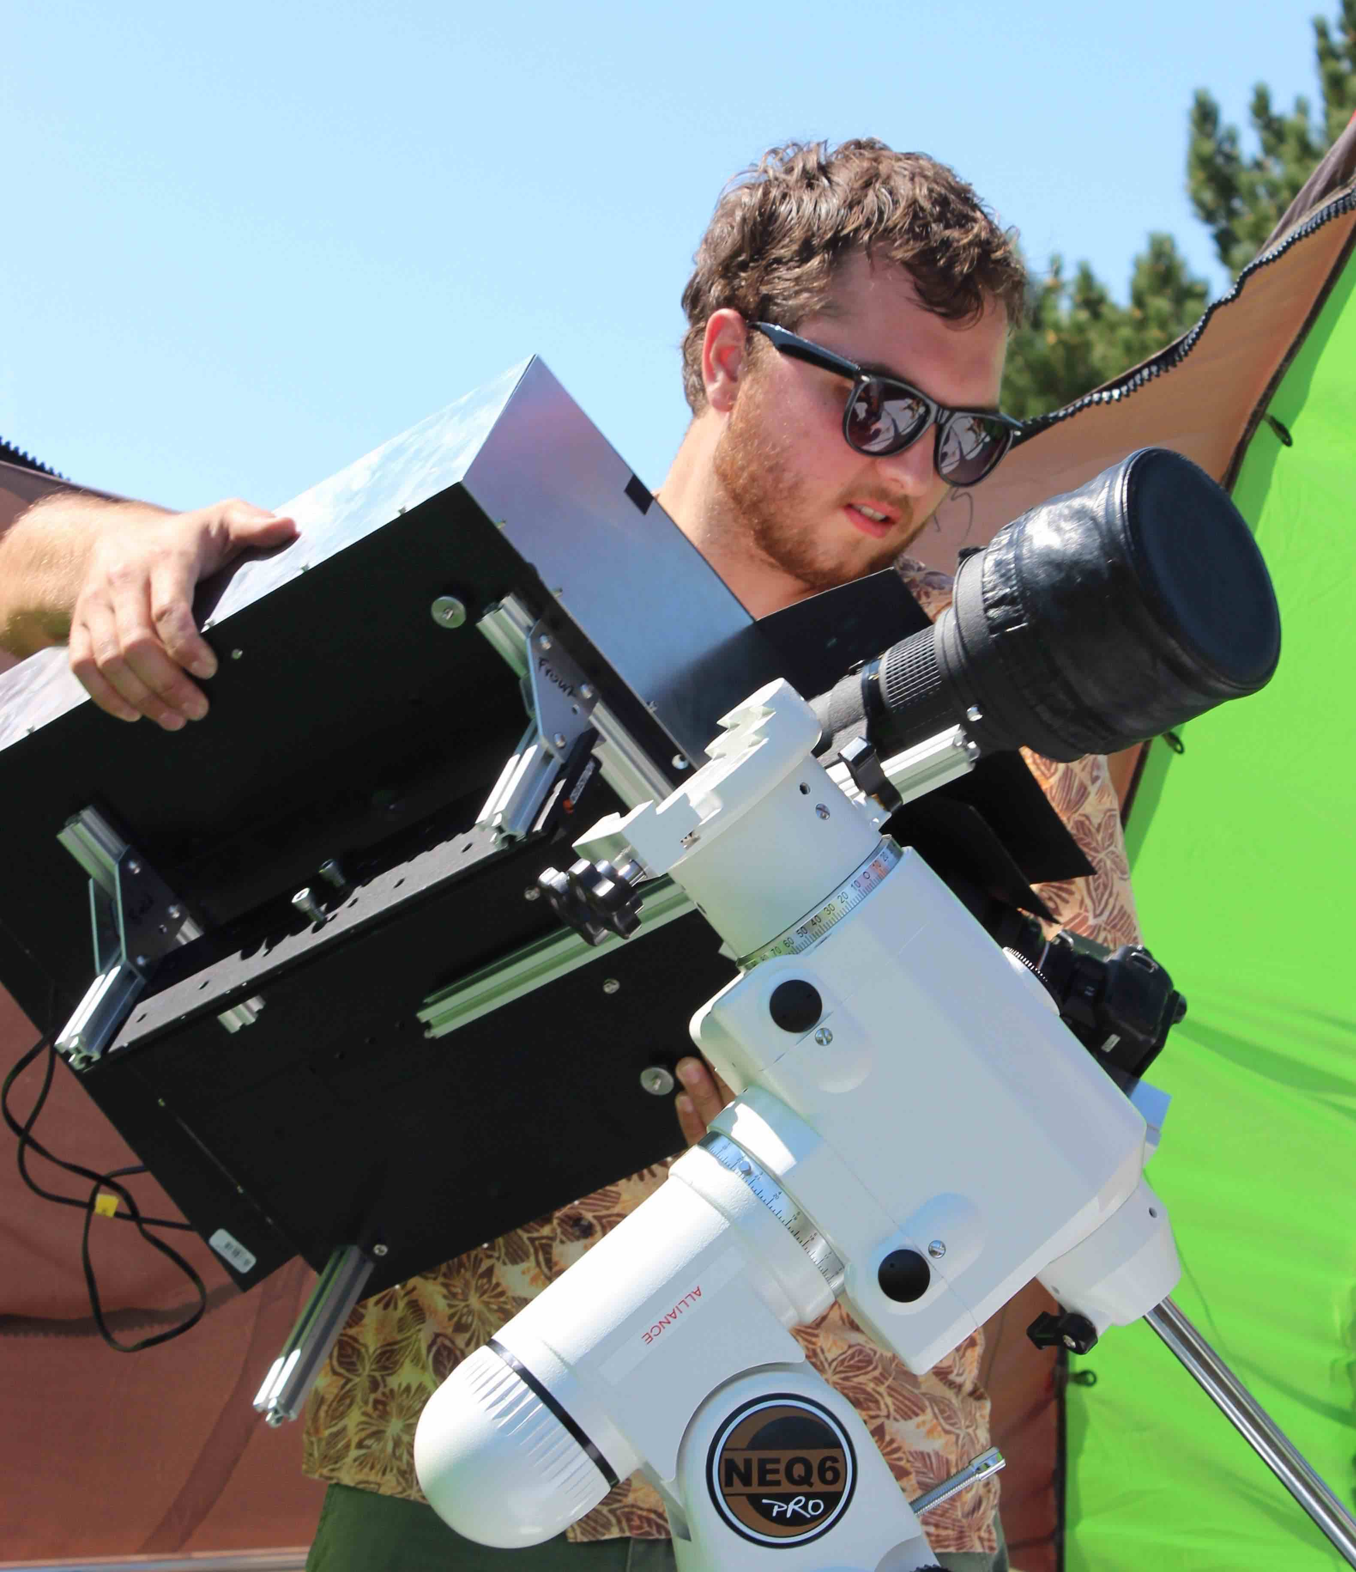
Shadia Habbal & Ben Boe
© Gerard Williger 2023, U Louisville
Habbal: Born in Syria, BS U Damascus, MS Am. U of Beirut, PhD Cincinnati ’77, worked at Harvard; Prof at U Hawaii
Research on solar wind, eclipse polarimetry
Led 10 eclipse expeditions since 1995
Major role with NASA Parker Solar Probe
2.5’ VIDEO, 2016 UH Solar Eclipse Interview, UH News
Habbal, U. Hawaii
Boe, wordpress.com
Boe, PhD 2020 with Habbal, currently Asst Prof at Wentworth Inst. of Tech.

Slide 29
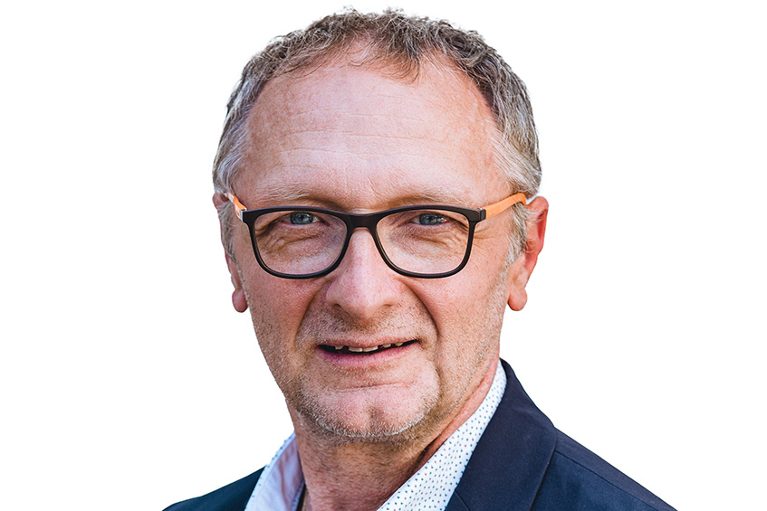
Franz Kerschbaum
© Gerard Williger 2023, U Louisville
Kerschbaum, Austrian, Univ. Vienna
Prof, Vice Dean, U. Vienna
MS ’88, PhD ’93, U Vienna, variable and giant stars
Did research in France, Sweden, returned in 2001
112 articles, 5900 citations
Active in public outreach, history of science
Wrote popular book -- Sun, Moon and Stars: 52 cosmic answers (Seifert Publ., 2010)
Researches shadow bands
Wrote about 1631 Venus transit LINK
--Saw Jul 31, 1981 eclipse in Caucausus at dawn, age 17, wanted to see another
--Clouded out Aug. 11, 1999 in Austria
--Saw and photographed shadow bands, Mar. 29, 2006, Al Sellum, Egypt (best one)
SHOW 34” VIDEO
MESSAGE TO STUDENTS: “When observing a solar eclipse, don’t make too many plans, but enjoy!”

Slide 30
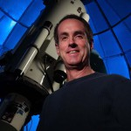
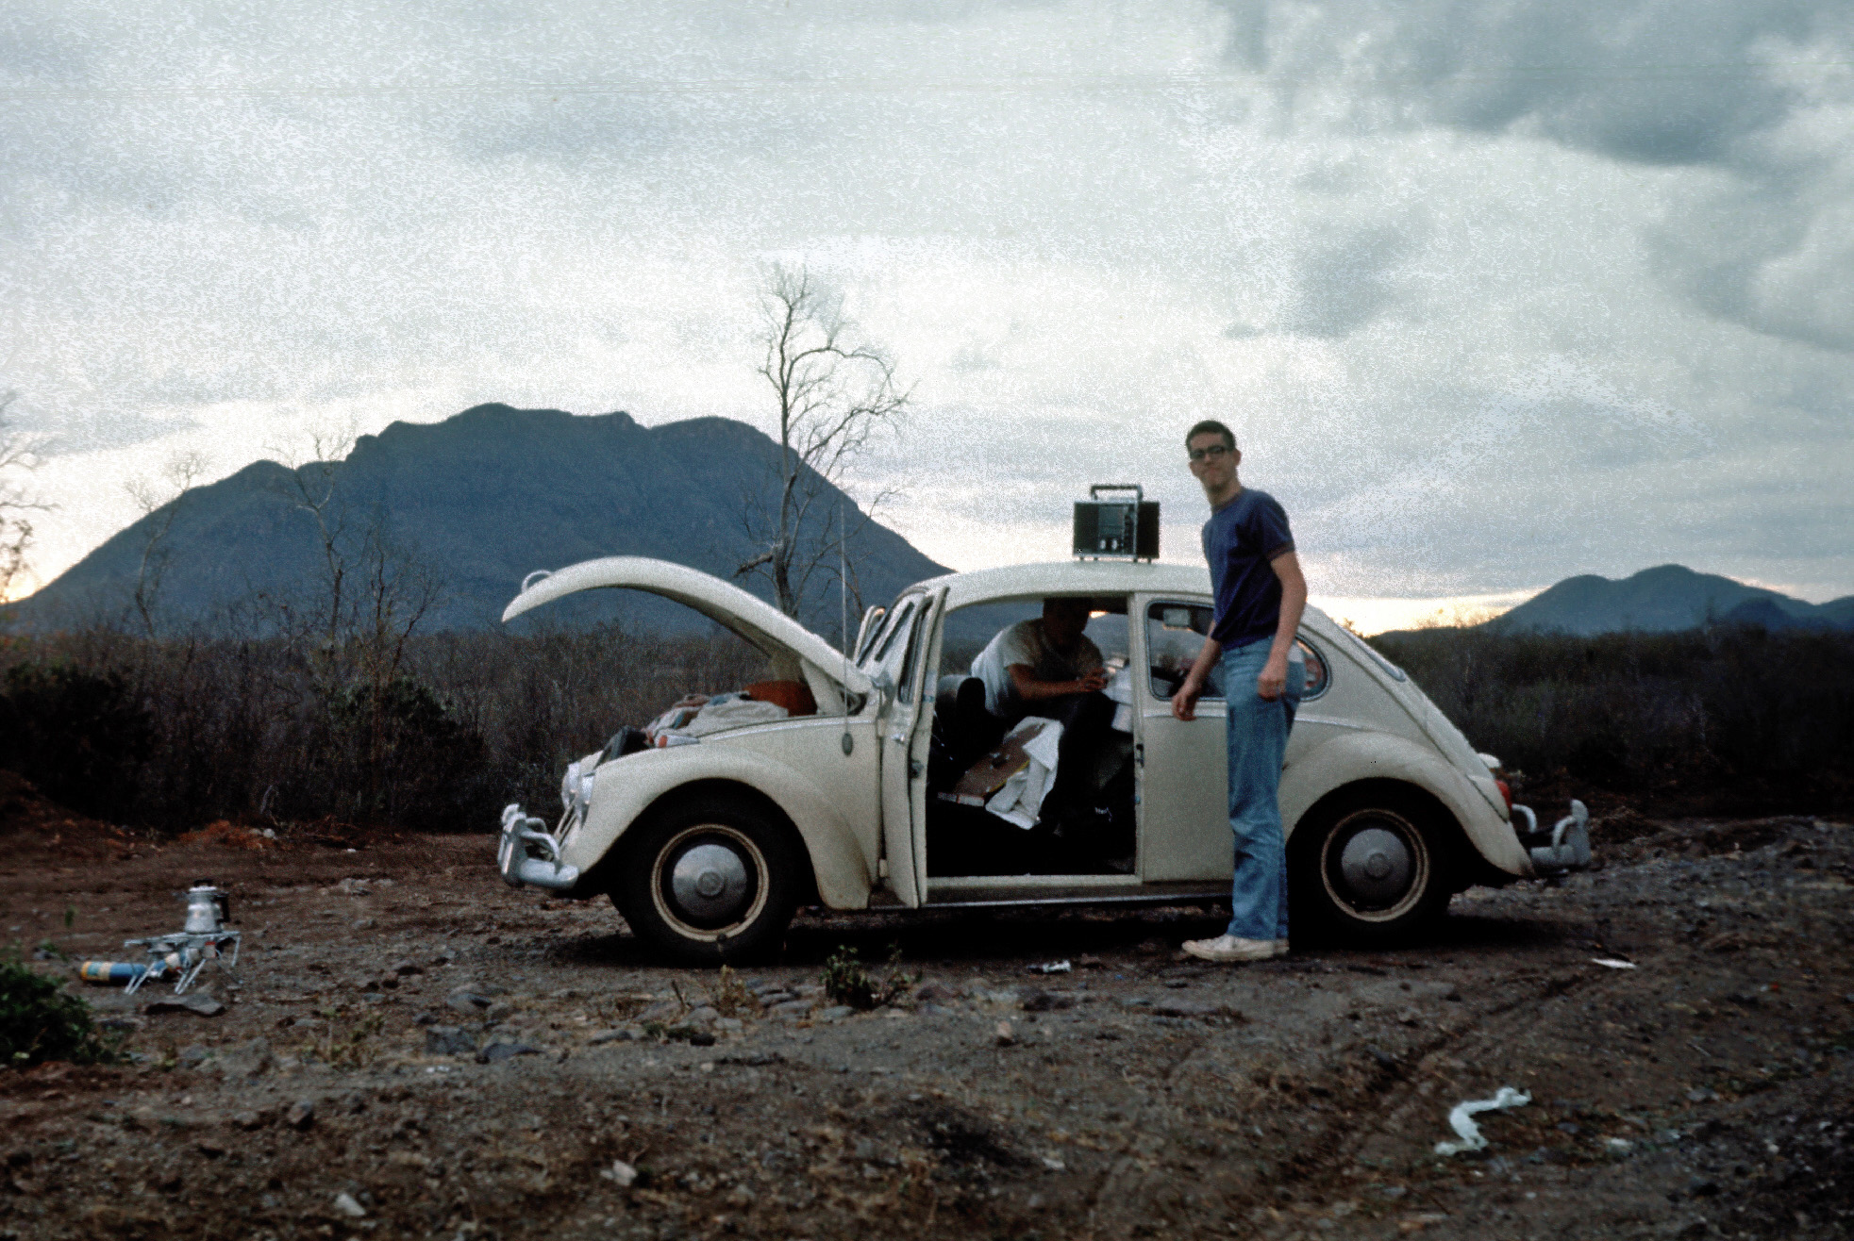
Doug Duncan - I
© Gerard Williger 2023, U Louisville
Provided by Doug Duncan
US, Wanted to be an astronomer since 2nd grade
BS Caltech, PhD ‘81 UC-Santa Cruz,
On lithium depletion and chromospheric emission in solar-type stars
Prof Emeritus, former Dir. Fiske Planetarium, U Colorado
Teaching specialist
1st book on clickers in classroom
Effect of texting in class on grades
Invented Solar Snap, app for solar photos with a smartphone LINK
Made 8 hour online course, The Sun and the Total Eclipse of 2017, 5200 students by Nov. 2023
Leading “Totality Over Texas” 2024
1st eclipse: driving trip to Oaxaca, Mexico, 1970
“You lose all track of time. How vastly different a total eclipse is…”
SOURCE LINK
Technique: “Record a countdown so I don't lose track of time during totality. Use binoculars during totality.”

Slide 31
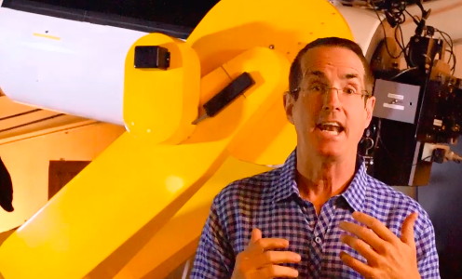
Doug Duncan - II
© Gerard Williger 2023, U Louisville
Special eclipse: “1991 was the most beautiful. Incredible bright prominence, like a bright LED at the sun's edge. Brought my parents. Mother burst into tears at the beauty.”
1’ VIDEO, Animals at an Eclipse, by Doug Duncan
Message to students: “See totality sometime in your life. You will never, ever forget it!"

Slide 32


Miloslav Druckmüller
© Gerard Williger 2023, U Louisville
Czech mathematician, eclipse photographer Wikipedia (in Czech)
PhD ’82 Masaryk U, Prof since 2001, Brno U of Technology
Photo: Druckmüller website
Observed 29 solar, 3 lunar eclipses since 1980
Corona up to 9 solar radii

Slide 33



Kate Russo - I
© Gerard Williger 2023, U Louisville
Photo supplied by K. Russo
Born, currently in Australia
lived in N. Ireland for 20 yrs
Observed 13 eclipses, “chasing” since 1999
Site beingintheshadow.com
Clinical Psychologist
Two areas of research:
- experience of totality (published three books)
- community eclipse planning (White Papers, two editions)
Featured in media to share totality as a nature event
2012
2017

Slide 34


Kate Russo - II
© Gerard Williger 2023, U Louisville
Eclipse chaser, KENS-5 TV, San Antonio, Oct 2023, before annular eclipse FYI 2.3’ VIDEO
Photos courtesy of K. Russo, 2023

